Slide 1

Plinth
A basis for scalable, inter-disciplinary data usage
Image source: https://auction.catawiki.com/kavels/10808761-bronzed-sculpture-on-marble-plinth-a-dynamic-team

Slide 2
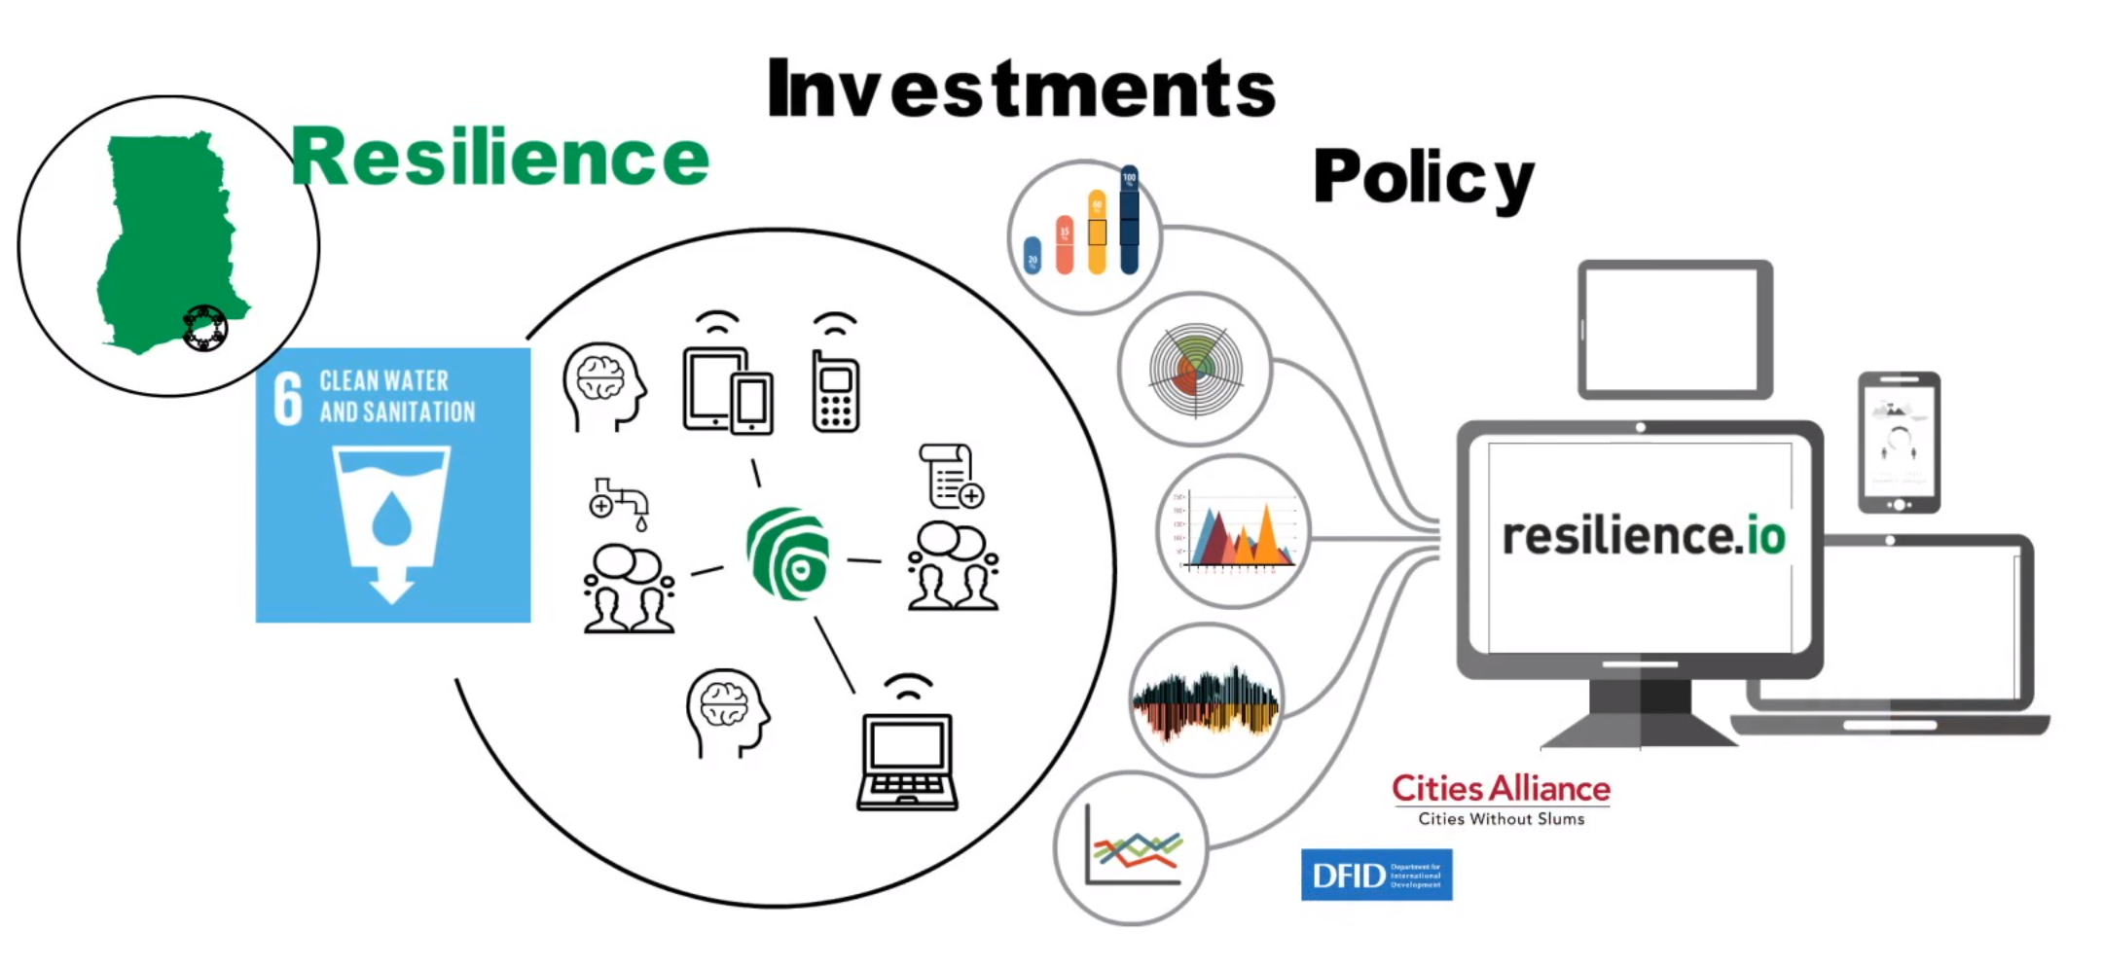

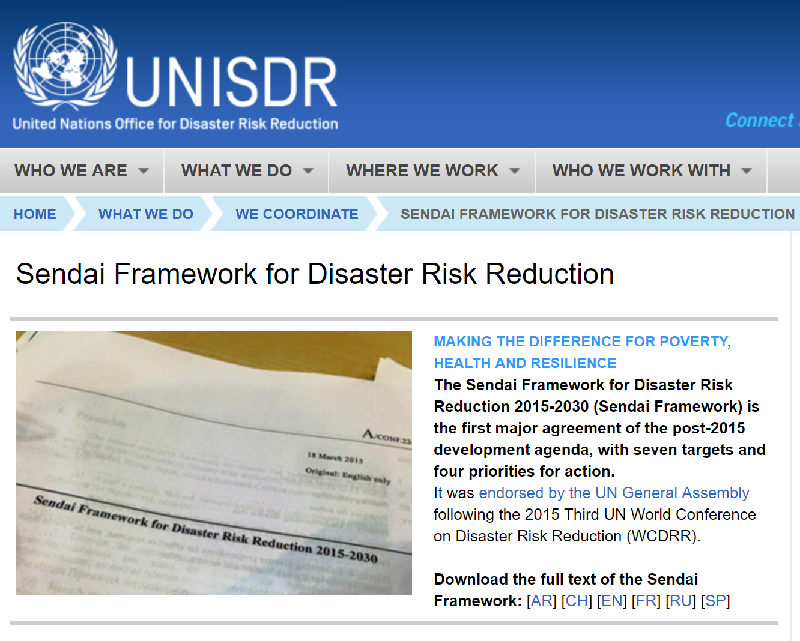
Our pilots
Notes:
General intro to each of the pilots. Emphasise that they already have tools and procedures in place (especially IDDO and resilience.io).
Already able to integrate a lot of data - but it’s highly manual.

Slide 3
Our pilots
Already exist
Have established systems and methods of working
Have clearly defined tasks
Many outcomes are already achieved
Notes:
Summary of the previous points

Slide 4







Globally…
Notes:
There are loads of efforts in this space, many of which are very good. There are repositories, repositories of repositories, metadata aggregations, virtual research environments, identifier reconciliation services (openphacts), DataCite, CrossRef etc.

Slide 5

Time to relax by Dimitar Nikolov cc-by https://flic.kr/p/8rs71z
Notes:
So we can all put our feet up - everything’s been done.

Slide 6

Working hard for a cup of coffee 1 by R. Halfpaap cc-by-nd https://flic.kr/p/qF8vja
Notes:
And yet... researchers using other researchers’ data is the exception, not the norm.
There are a few high quality datasets used repeatedly (census data for example) but the majority of data sits in repos unused.
Clearly we have a lot of work to do.

Slide 7

It’s about scale
Notes:
Scale is the issue.
We need to reduce the amount of human effort required (the picture is the ‘Pale Blue Dot’ pic taken by Voyager 1 on 14 Feb 1990 - the dot is Earth)

Slide 8
Aims
To the greatest extent possible, Plinth will automate:
The automatic discovery of reports and datasets that have relevance to given research topics.
Ontology-based reconciliation of data:
across datasets;
across disciplinary boundaries;
extracted from reports.
The mediation of queries across datasets.

Slide 9
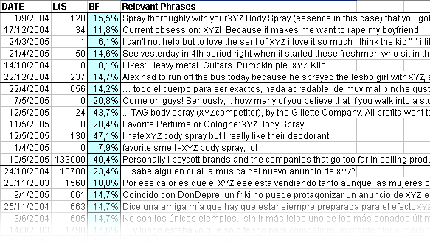


Machine learning - Sentiment analysis
Notes:
First topic: machine learning
Here’s an application of machine learning, named entity extraction etc.
The commercial service (i-sieve) helps advertising agencies to measure the impact of their campaigns and sponsorships. They train crawlers to find comments about products and services on social media, blog post and mainstream media comments - then classify them into positive, negative and neutral, clustering the comments into motivations so they can report back what people think and why.
They measure for how long a sponsor name appears on a screen, its size and relative position, whether the commentator mentions the sponsor and, if so, whether that mention is enthusiastic or not.
We can use the same techniques for research data.
We can train the system by showing it a corpus of datasets about a topic, it can learn from the patterns and then be sent to crawl the Web for datasets with varying degrees of isomorphism, that is, it can find related data. And it can do that by looking at the metadata, and at the data itself.
If you know a lot about Ebola in West Africa, it can find datasets about other diseases in the same area, or diseases with similar patterns of infection anywhere so you can compare transmission vectors.

Slide 10
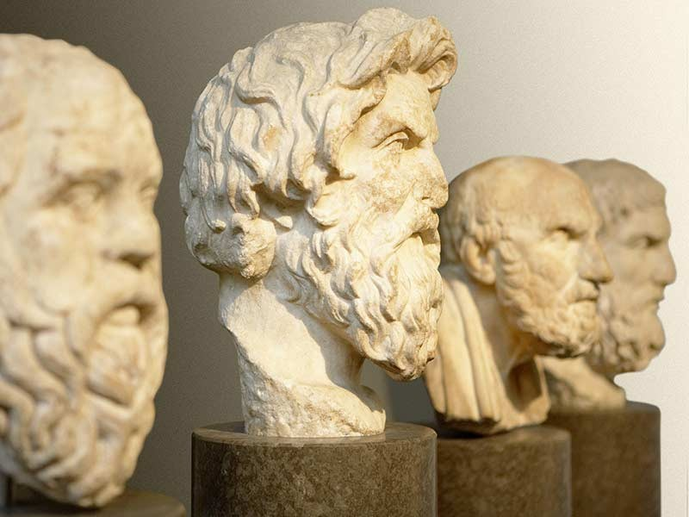
Notes:
The person behind this, Konstantinos Chandrinos, formerly at the national Centre for Scientific Research in Athens,
is Greek and therefore veers towards Greek philosophy.

Slide 11
Machine learning
All structures we call ontologies are but segments of THE ontology, currently unattainable
(Dean of the University of Athens)
Interpretation: all kinds of representation are detrimental ontologies

Slide 12
Thus:
A table with headers and data; a graph with axes but with or without legend; a sequence of numbers representing measurements, are all detrimental ontologies, being representations.

Slide 13
ML practitioner’s rephrasing of the project:
Can I find different representations for related data? (e.g. fluctuations of GDP and per capita income for the years I have data on Ebola spread?)
AND
Can I find related representations for different data? (e.g. fluctuations in spread of malaria for the years I have data on Ebola spread?)

Slide 14
In short: yes
this can be done at the sole abstraction level of the term "West Africa over period X" statistics. The technicalities are there to make this as automated as possible, including the automatic deduction that your original data speak about West Africa in the period 2000-2020, let alone the crawling and discovery of the rest.

Slide 15

Semantic Data Lake
Data Lake
Repository of data stored in its original formats
Structured, semi-structured, unstructured data
Schema-less
Current ‘universal’ data landscape corresponds to a data lake
Semantic Data Lake
Add a Semantic Layer on top of source datasets
The data is semantically lifted using ontologies
Provide a uniform view over multiform data
Data is not necessarily ported or transformed!
Notes:
New topic: Semantic Data Lake.
Data Lakes are not new, but Fraunhofer have added a semantic layer on top of a data lake.
This was done as part of the Big Data Europe project that built a Docker-based system to create customised big data workflows.

Slide 16
Retrieving data from the Semantic Data Lake
A SPARQL query is decomposed into sub-queries
Sub-queries target different native data sources
Retain Links between sub-queries to reconcile data returned from each
Data Lake is checked for candidate data sources that can answer each sub-query (by consulting metadata)
Sub-queries are translated to native query language of the selected relevant/candidate data source
Examples: SPARQL to SQL, or SPARQL to CQL (Cassandra)
Sub-results are joined together to form an integrated result

Slide 17


Semantic Data Lake – Envisaged Architecture
Execution Plan
Decomposing
User Query
SPARQL query
Metadata
property -> data source (type)
SQL
?item gho:Country ?country .
?item gho:Disease ?disease .
...
MongoDB
Finding Relevant Data Sources
Queries Translation
XML
SELECT country, disease, ... FROM Observations
SQL
SQL
XPath
JSONPath
Database
XML File
MongoDB
Notes:
The Squerall project has proved initially promising results but needs further development.
Performance is better than the traditional integration at ingestion time - i.e. mapping everything to a single unified data model.
You only query relevant data, not the whole lot, looking for things that aren’t there.

Slide 18
Semantic Data Lake – Result Reconciliation
Final Results
Execution Plan
Links between sub-queries
Result Reconciliation
Database
XML File
MongoDB
Notes:
It has been proven at a basic level – now needs work and development to make it more production-ready.

Slide 19

Squerall – realising the Semantic Data Lake
Reference implementation using Apache Spark & Presto (SQL)
Leverages Spark/Presto Connectors
Access to dozens of heterogeneous databases (wrappers)
Used to load data to distributable data structures (DataFrames in Spark)
=> Uniform SPARQL (external) to SQL (internal) interface
GUIs:
Mappings UI: extracting and mapping data attributes to ontology terms
Query UI: visual SPARQL builder (autosuggests predicates from data)
https://github.com/EIS-Bonn/Squerall
Notes:
(probably drop this slide - I admit I don’t know the details it talks about)

Slide 20
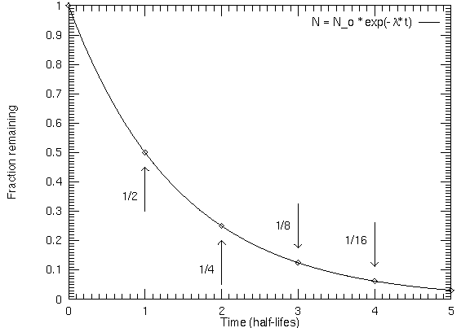
Required human effort should reduce over time
Notes:
If we do this, and include tools for things like data extraction from PDFs, reconciliation APIs and more, we can create a platform - a plinth - that reduces the amount of human effort required to find and use relevant data.
It will never fall to zero
the Semantic Data Lake, for example, will always need human-created ontologies,
the Web crawler will always need to be trained and tweaked.
But it should help to make the use of other researchers’ data more routine and allow them to spend less of their time on data integration and more of it on answering research questions.

Slide 21

Balancar by erp_wyatt https://flic.kr/p/22gq93o cc-by-nc-nd
Notes:
Sounds like science fiction

Slide 22
It’s not science fiction
Human-developed ontologies
Machine learning/Web crawling
Proven query mediation
Good API design
…it’s the plinth

